Slide 1
Project Milestone 1
Nick Brennan-Martin

Slide 2
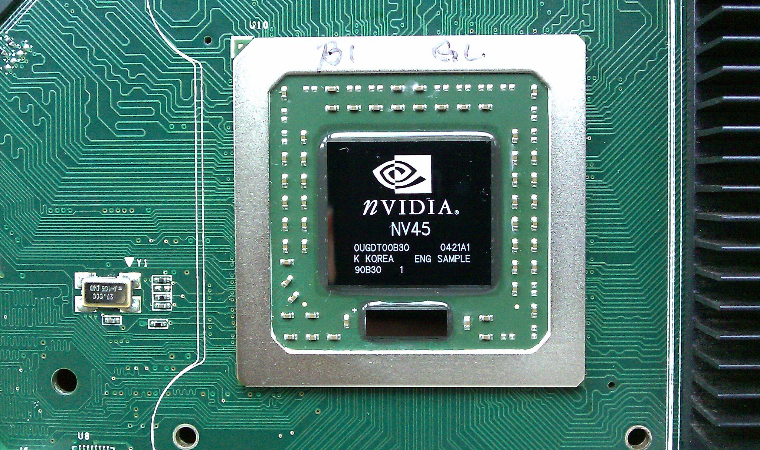
What are GPUs
Graphic Processing Unit
Manipulate Computer Graphics and Image Processing
Parallel Structure
Two Main Makers
Growing Field

Slide 3
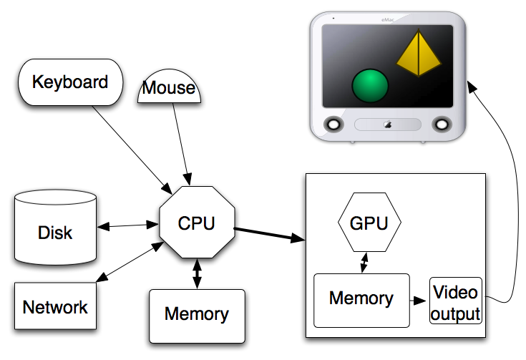
GPU vs CPU
GPU
Parallel Processing
Handle Thousand Operations At Once
Low Memory Consumption
Act as a Microprocessor
CPU
Serial Processing
Handle Few Operations At Once
High Memory Consumption
The Brain of the Computer

Slide 4
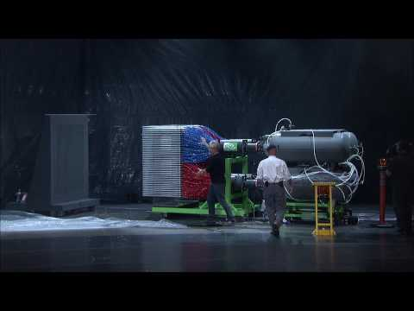

Slide 5
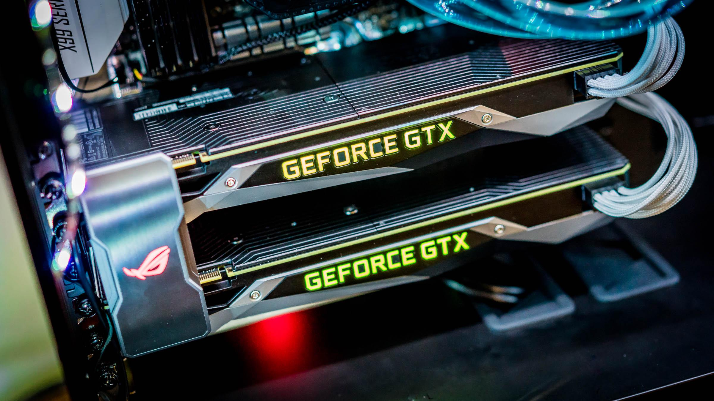
GPUs in the Industry
AI
Machine Learning
Games
Simulations
Banking
Self Driving Cars

Slide 6
My Idea
GPU Physics
Learn What is Possible
Try New Algorithms
Do What I Could Not Do On the CPU

Slide 7
Other Aspects
Done In Unity
Decide On the API
Learning Towards Vulkan
Figuring out Final Physics Algorithm to Simulate

Slide 8
Sources
https://youtu.be/-P28LKWTzrI
Images from built in search bar

